Slide 1
B -Tree and B+ Tree

Slide 2
B -Tree
B tree is a self-balancing tree, and it is a m-way tree where m defines the order of the tree.
B tree is a generalization of the Binary Search tree in which a node can have more than one key and more than two children depending upon the value of m.
In the B tree, the data is specified in a sorted order having lower values on the left subtree and higher values in the right subtree.

Slide 3
Properties of B -Tree
If the B tree has an order of m, then each node can have a maximum of m In the case of minimum children, the leaf nodes have zero children, the root node has two children, and the internal nodes have a ceiling of m/2.
Each node can have maximum (m-1) keys. For example, if the value of m is 5 then the maximum value of keys is 4.
The root node has minimum one key, whereas all the other nodes except the root node have (ceiling of m/2 minus - 1) minimum keys.
If we perform insertion in the B tree, then the node is always inserted in the leaf node.

Slide 4
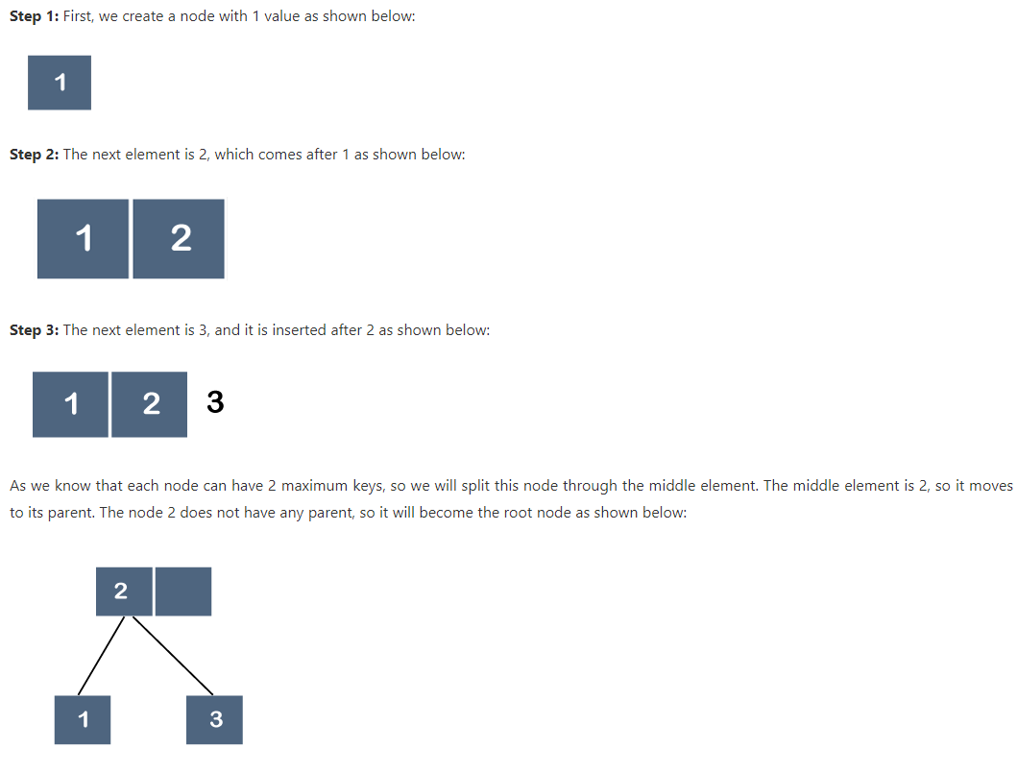
Example of B –Tree
Suppose we want to create a B tree of order 3 by inserting values from 1 to 10.

Slide 5
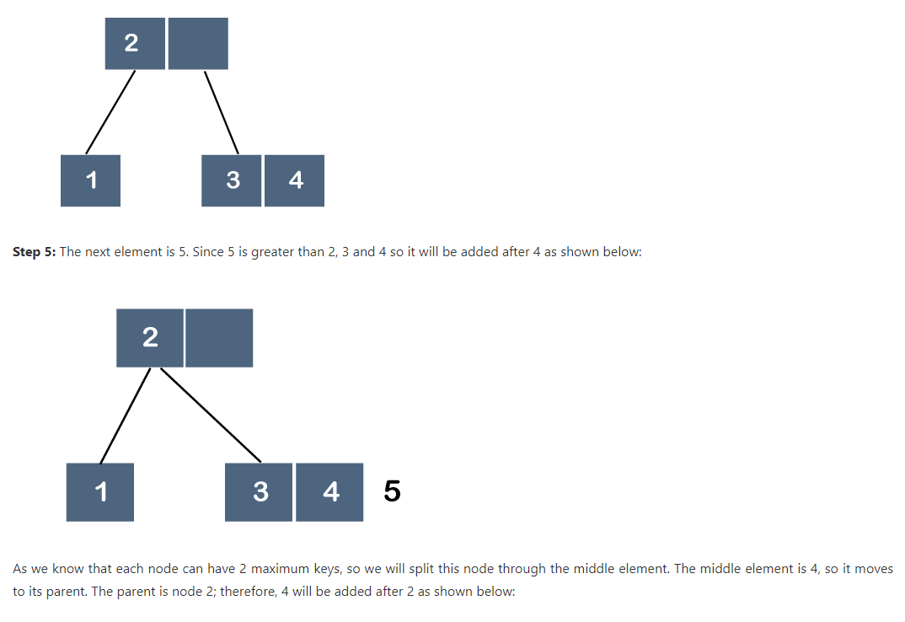
Example of B –Tree
Suppose we want to create a B tree of order 3 by inserting values from 1 to 10.

Slide 6
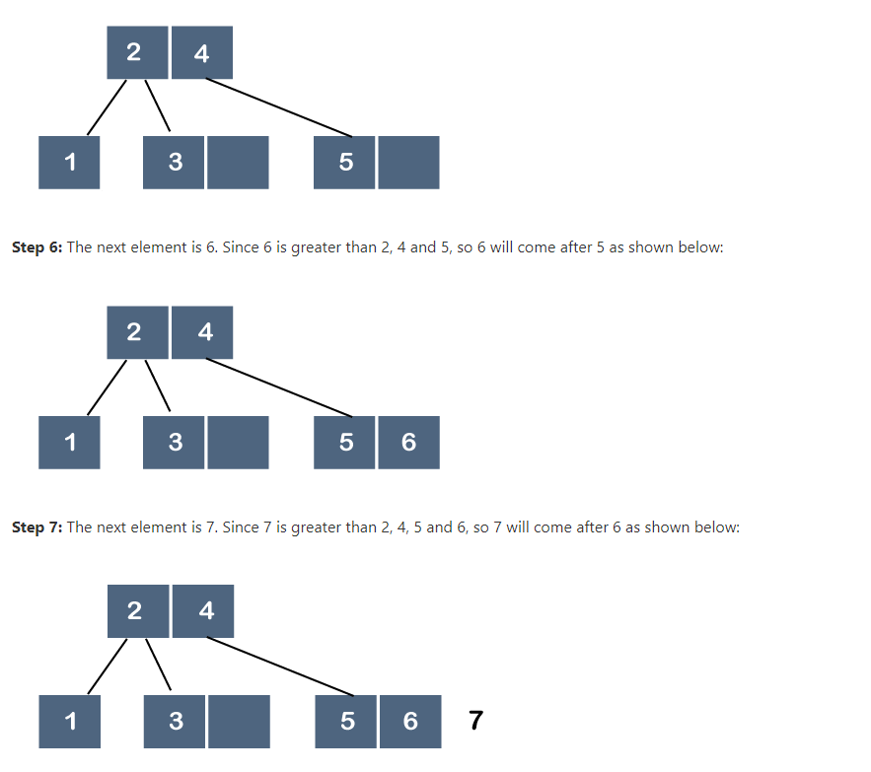
Example of B –Tree
Suppose we want to create a B tree of order 3 by inserting values from 1 to 10.

Slide 7
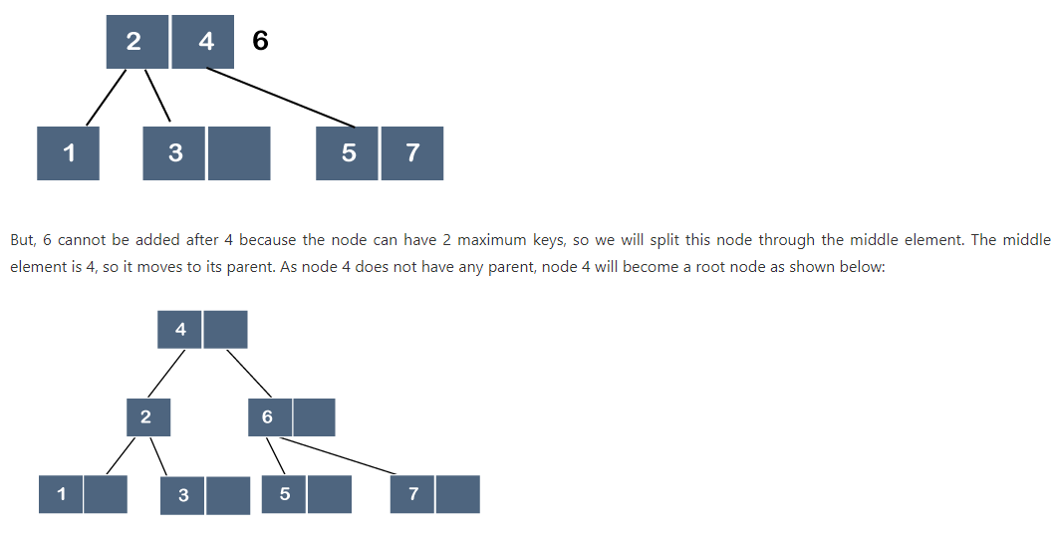
Example of B –Tree
Suppose we want to create a B tree of order 3 by inserting values from 1 to 10.

Slide 8
B+ Tree
The B+ tree is also known as an advanced self-balanced tree because every path from the root of the tree to the leaf of the tree has the same length.
Here, the same length means that all the leaf nodes occur at the same level.
It will not happen that some of the leaf nodes occur at the third level and some of them at the second level.
A B+ tree index is considered a multi-level index, but the B+ tree structure is not similar to the multi-level index sequential files.

Slide 9
B+ Tree
The B+ tree is also known as an advanced self-balanced tree because every path from the root of the tree to the leaf of the tree has the same length.
Here, the same length means that all the leaf nodes occur at the same level.
It will not happen that some of the leaf nodes occur at the third level and some of them at the second level.
B+ tree index is considered a multi-level index, but the B+ tree structure is not similar to the multi-level index sequential files.
B+ tree is used to store the records very efficiently by storing the records in an indexed manner using the B+ tree indexed structure. Due to the multi-level indexing, the data accessing becomes faster and easier.

Slide 10
B+ Tree
In B+ tree leaf node denote actual data pointers.
Leaf node are linked using link list, therefore B+ tree can support random access as well as sequential access.
An internal node of B+ tree can contain atleast n/2 record pointers except the root node. At most an internal node of the tree contains n pointers.
The leaf node of the B+ tree can contains atleast n/2 record pointers and n/2 key values.

Slide 11
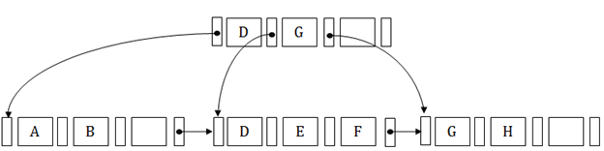
Structure of B+ Tree
In the B+ tree, every leaf node is at equal distance from the root node. The B+ tree is of the order n where n is fixed for every B+ tree.
It contains an internal node and leaf node.

Slide 12
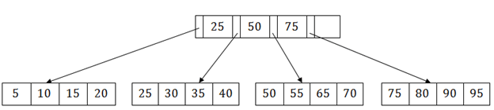
Searching a record in B+ Tree
Suppose we have to search 55 in the below B+ tree structure. First, we will fetch for the intermediary node which will direct to the leaf node that can contain a record for 55.
So, in the intermediary node, we will find a branch between 50 and 75 nodes. Then at the end, we will be redirected to the third leaf node. Here DBMS will perform a sequential search to find 55.

Slide 13
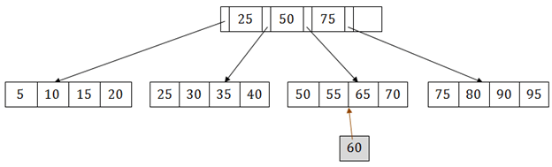
B+ Tree Insertion
Suppose we want to insert a record 60 in the below structure. It will go to the 3rd leaf node after 55. It is a balanced tree, and a leaf node of this tree is already full, so we cannot insert 60 there.
In this case, we have to split the leaf node, so that it can be inserted into tree without affecting the fill factor, balance and order.

Slide 14
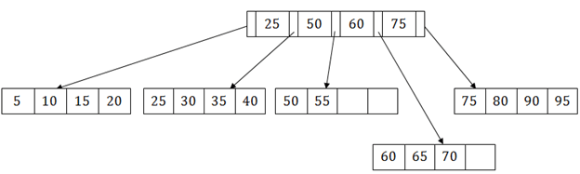
B+ Tree Insertion
The 3rd leaf node has the values (50, 55, 60, 65, 70) and its current root node is 50. We will split the leaf node of the tree in the middle so that its balance is not altered. So we can group (50, 55) and (60, 65, 70) into 2 leaf nodes.
If these two has to be leaf nodes, the intermediate node cannot branch from 50. It should have 60 added to it, and then we can have pointers to a new leaf node.

Slide 15
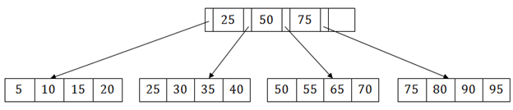
B+ Tree Deletion
Suppose we want to delete 60 from the above example. In this case, we have to remove 60 from the intermediate node as well as from the 4th leaf node too. If we remove it from the intermediate node, then the tree will not satisfy the rule of the B+ tree. So we need to modify it to have a balanced tree.
After deleting node 60 from above B+ tree and re-arranging the nodes, it will show as follows:

Slide 16
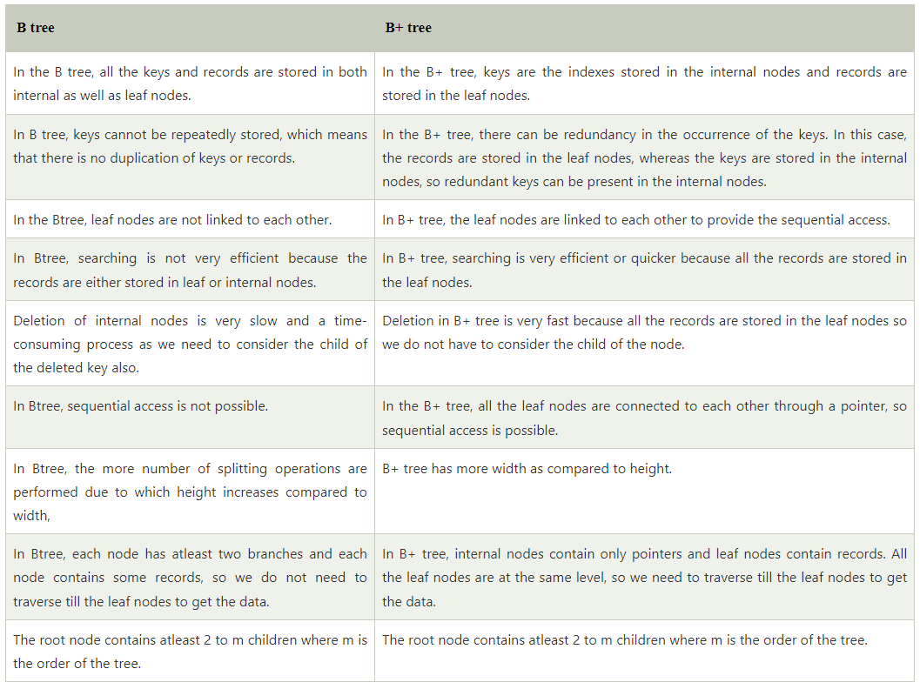
Difference between B and B+ Tree

